Slide 1
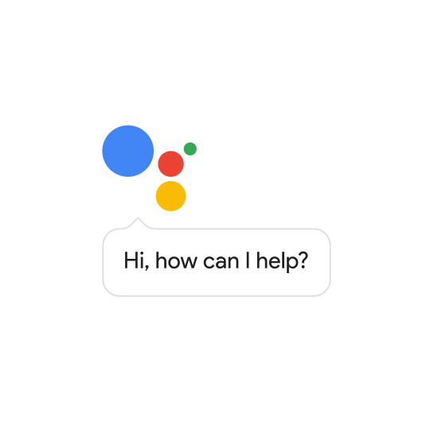
Google Assistant
Community Day
Christina Resing && Tomasz Krajewski

Slide 2
Agenda
1
Short Introduction
2
How to Write a Skill
3
Coding Session

Slide 3
Google Assistant facts
Presented on 18 May 2016 during Google’s developer conference
May 2018. Google presented Duplex. It is an extension of Google Assistant which allows it to carry out natural conversations by mimicking human voice (under further development). Phone call on behalf of its user
https://www.youtube.com/watch?v=-qCanuYrR0g
More than 30 languages, spread across 80 countries by the year-end
is used in across more than 500 million devices, including smart speakers, phones, cars, TVs, headphones, and many more

Slide 4
Google Assistant supported languages
Available:
Chinese, Danish, Dutch, English (Australia, Canada, Singapore, UK, US), French (Canada, France), German Hindi, Indonesian, Italian, Japanese, Korean, Norwegian, Portuguese (Brazil), Russian, Spanish, Swedish, Thai
Soon:
Arabic (Egypt, Saudi Arabia), Bengali, English (India, Indonesia, Ireland, Philippines, Thailand), German (Austria), Malayalam, Marathi, Polish, Spanish (Argentina, Chile, Colombia, Peru), Tamil, Telugu, Turkish, Urdu
(source: https://www.xda-developers.com/google-assistant-new-languages-list/)

Slide 5
The Best Things Google Assistant Can Do
Open apps with your voice
Get advice on where to eat, drink, dance or shop
Play your favorite Netflix shows and movies
Send a voice message
Book movie tickets
Set important reminders
Give Google Assistant your shopping list
Send a text message
Turn on and off your TV
See if things add up
Translate English to other languages
Make hands-free calls
Find your lost phone.

Slide 6

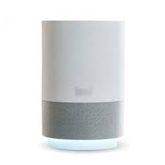
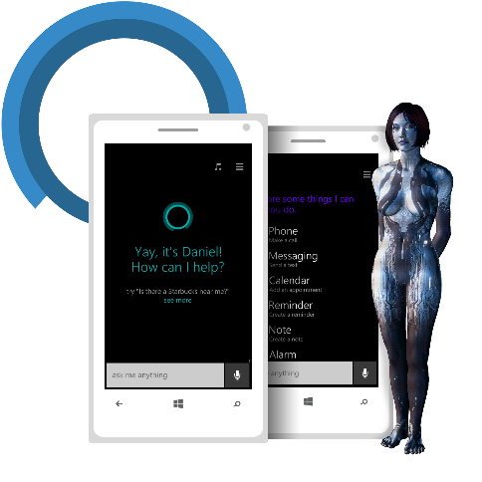
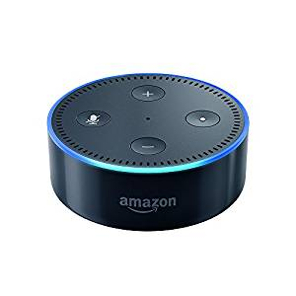
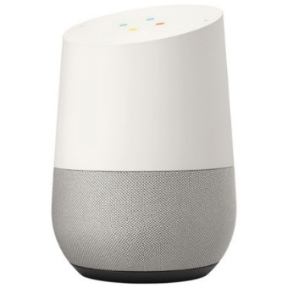





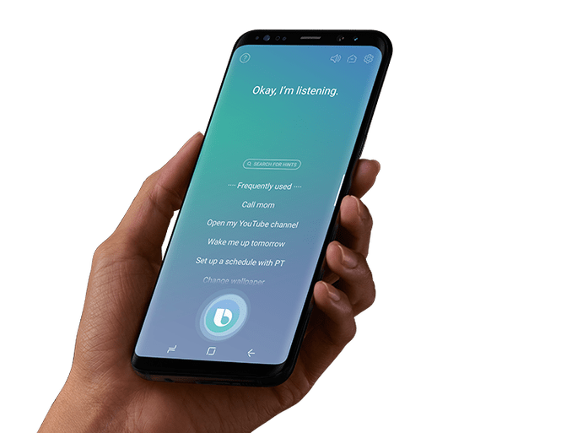
What is going on right now?
tech giants fight crucial battle over voice recognition

Slide 7
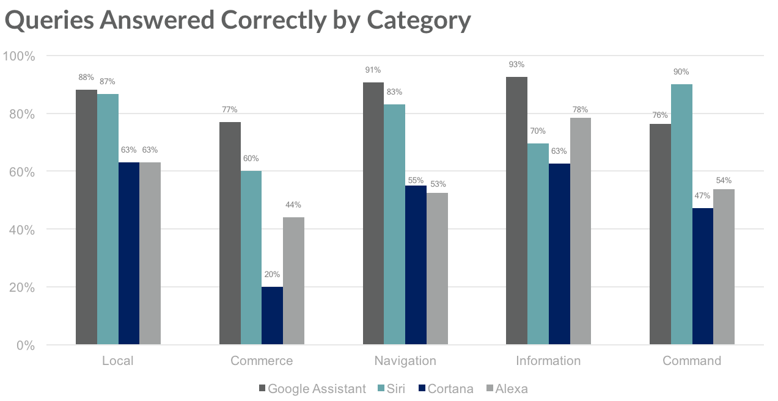
Different Categories Reflect Different Assistant Strengths (Loup Ventures Annual Digital Assistant IQ Test)
https://voicebot.ai/2018/07/26/google-assistant-most-capable-finds-loup-ventures-cortana-the-least/

Slide 8
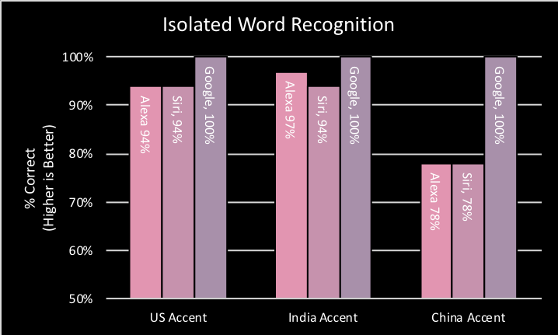
Google Assistant Takes Lead in Understanding Speakers with Accents
(source: https://voicebot.ai/2018/09/13/google-assistant-takes-lead-in-understanding-speakers-with-accents/

Slide 9
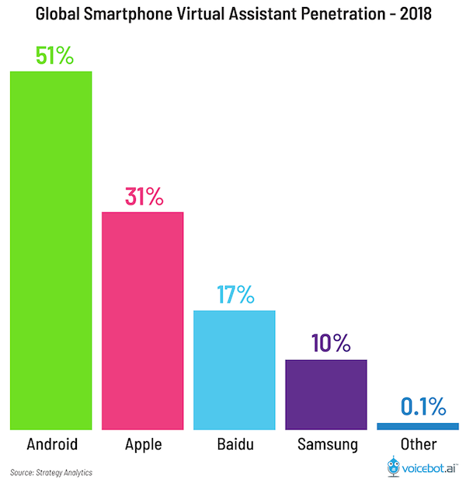
Assistant Market Share on Smartphones According to Strategy Analytics
https://voicebot.ai/2018/07/22/google-assistant-has-51-percent-virtual-assistant-market-share-on-smartphones-according-to-strategy-analytics/

Slide 10
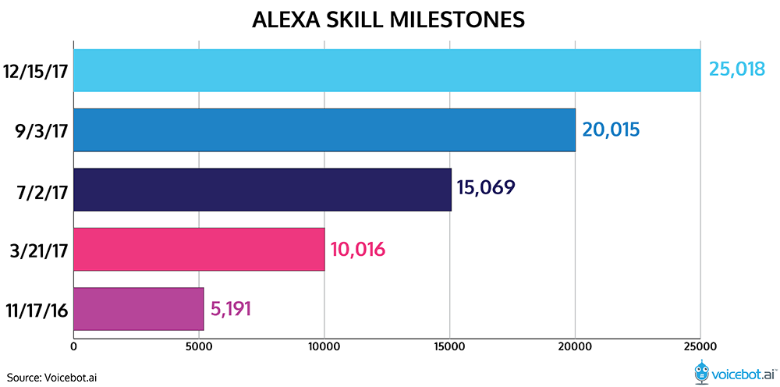
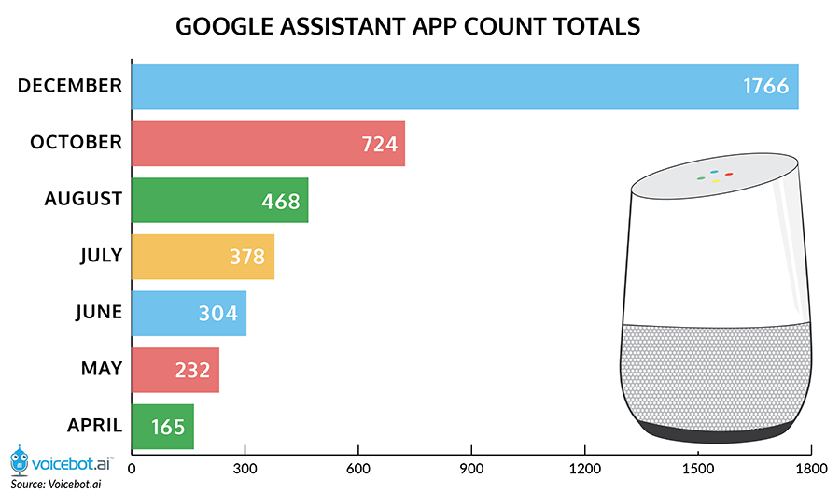
Alexa vs Google Home Skills fight in the USA market (December 2017)
Source: https://www.voicebot.ai/

Slide 11
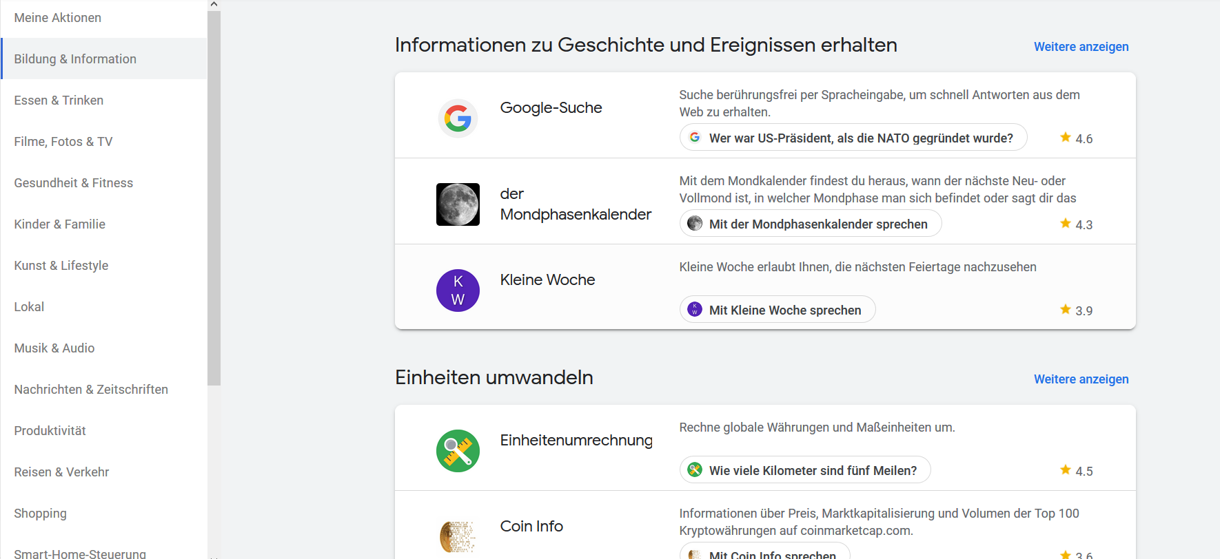
Google Assistent Market
https://assistant.google.com/explore/c/7/?hl=de-DE

Slide 12
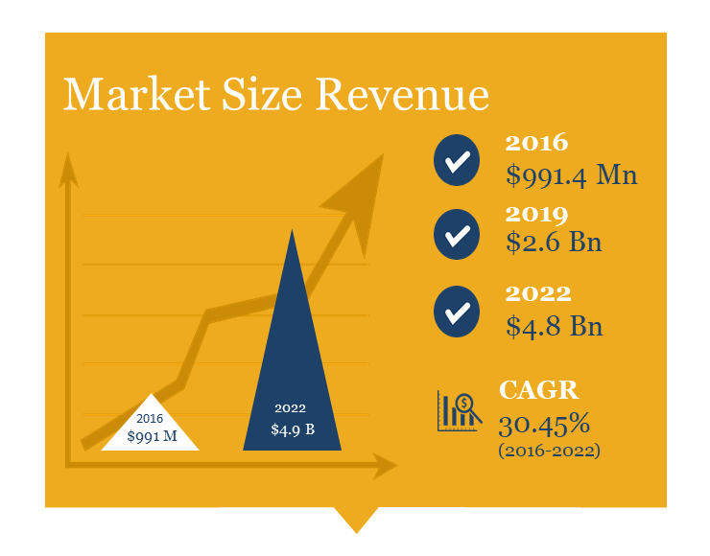
Arizton: Smart Speaker Market $4.8 Billion in 2022
Chicago-based research firm Arizton has a new report revealing that the smart speaker market was $991 million in 2016 and will grow to $4.8 billion in 2022
Source: https://www.voicebot.ai/

Slide 13
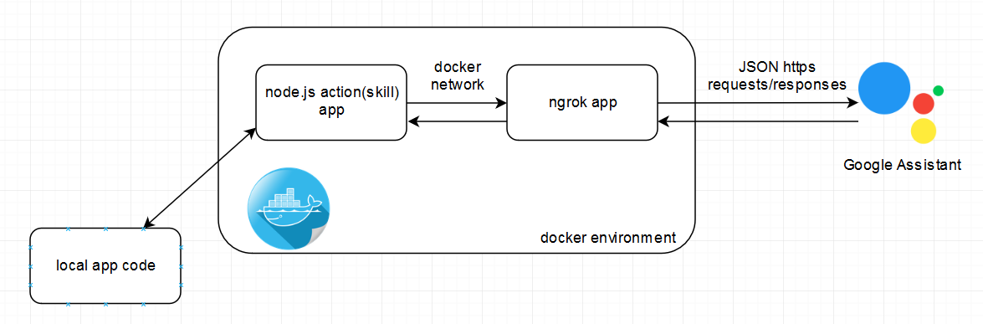
What is our idea?

Slide 14
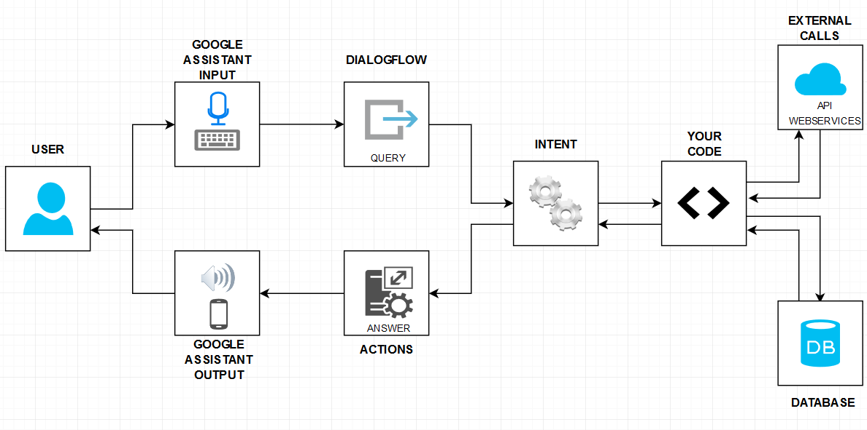
How it works?

Slide 15

How to write a Google Assistant skill?
2

Slide 16
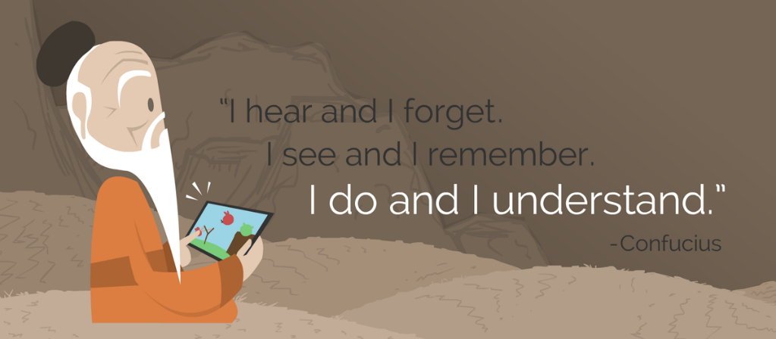

Let’s configure your new skill!

Slide 17
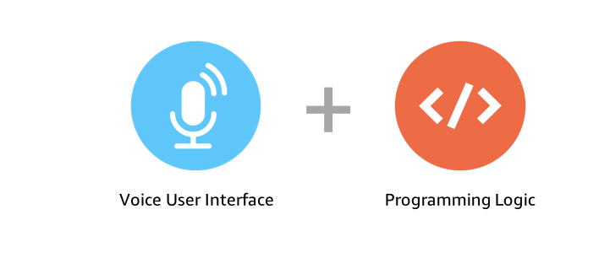

Creating first Action (skill)

Slide 18

Tasks for you!
Imagine OC got a project for a bike producer „Wasabi Bikes Japan”
You need to prepare a skill where a user can…

Slide 19
Task 1.1
Ask for a weather in any city of the world. The user needs to know values for the the following weather details:
a. temperature
b. apparent/"Feels Like" temperature
c. wind speed
d.relative humidity
e. cloud coverage (%)
f. accumulated liquid equivalent precipitation
You can use the following free version of the weather api weatherbit. Sign in to get the api key which is needed to request information about the weather (See Configure your api key in the tutorial).
https://www.weatherbit.io/account/create to sign in
https://www.weatherbit.io/api/weather-current the documentation

Slide 20
Task 1.2
The user likes to know what time weather observation was made. Our customer requests to format the datetime in am/pm convention but he wants that it will be a very flexible point. Please use the third party npm module „moment“ for it.
See the npm repository for documentation: https://www.npmjs.com/package/moment
How to restart docker find in our tutorial:
https://github.com/falent/googleHomeAssistantExpressNodeJS

Slide 21


Task 2
In the next step Wasabi Bikes Japan would like us to commercialize the skill…

Slide 22
Task 2.1
Please add a new intent.
The user likes to know the price for the three bike models of Wasabi Bikes Japan:
Road Bike (10323.111 JPY)
Mountain Bike (992323.111 JPY)
City Bike (93323.442 JPY)

Slide 23
Task 2.2
Save bike model and price of the user's choice in a session variable. (see Tutorial by Google for conv variables: https://codelabs.developers.google.com/codelabs/actions-2/index.html?index=..%2F..index#4)

Slide 24

Task III
Company is developing and decided to expand to the Europe with bike selling.

Slide 25
Task III.1
Our customer will sell his bikes for the change rate from today. Convert the price of the choosen model to EUR round the price to Euro Cent.
Please use https://exchangeratesapi.io/ API to convert prices with the date from yesterday to EUR.

Slide 26
Task III.2
Our customer decided that he will sell bikes only with the price from 2018-11-20. Please implement it that after you choose f.e Road Bike that the price will be displayed in EUR from rate on 2018-11-20.

Slide 27
Task IV.1
Please ask your user for a name and save his answer database. If user is in database make a personalized greeting ☺
Hint: please use conv obcject to get userId
To add database use a new docker container f.e
MongoDB
docker run -it --name mongo_database --network myNetwork bitnami/mongodb:latest
MySQL
docker run -it --name=mysql1 --network myNetwork -d mysql/mysql-server:5.7
docker logs mysql1 2>&1
docker exec -it mysql1 mysql -uroot -p

Slide 28
Some References for Google Assistant actions developing
https://www.npmjs.com/ - npm is the package manager for JavaScript and the world’s largest software registry
https://codelabs.developers.google.com/?cat=Assistant – Google Labs how to build actions (skills) in Node.js for google assistant
https://github.com/falent/googleHomeAssistantExpressNodeJS - Our tutorial for google assistant
https://github.com/falent/GoogleAssistantTutorial - our tutorial and code snippets
https://www.tutorialspoint.com/nodejs/ - Node.js Tutorial
https://dialogflow.com/docs/getting-started - Official DialogFlow documentation

Slide 29
Questions?

Slide 30


Thanks for your attention!
Tomasz Krajewski
Christina Resing
Associated Developer
Weltenburgerstarsse 4, 51647 München
Tomasz.krajewski@opitz-consulting.com
Associated Developer
Essen

